Slide 1
Priority Mailbox Final Project
University of Illinois Springfield – CSC570: Data Science Essentials
By Daniel Lee
5/11/2017

Slide 2
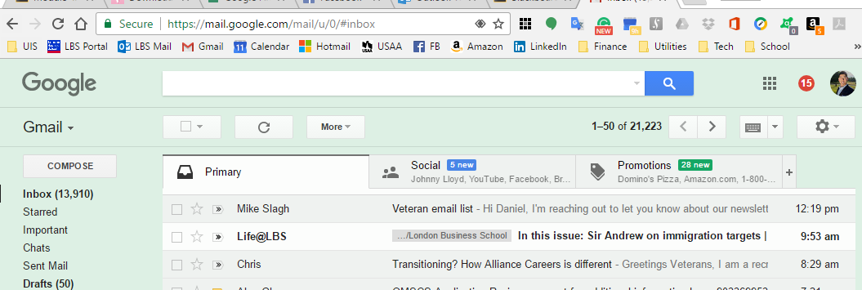
Problem Statement
Can I automate a “priority inbox” that filters emails I’m likely to read vs those I end up archiving as unread?
Lifespan Open Rate – 35%
Trailing 1-Year Open Rate ~ 20%
Train Naïve Bayes Classifier to predict whether or not I will open an email

Slide 3
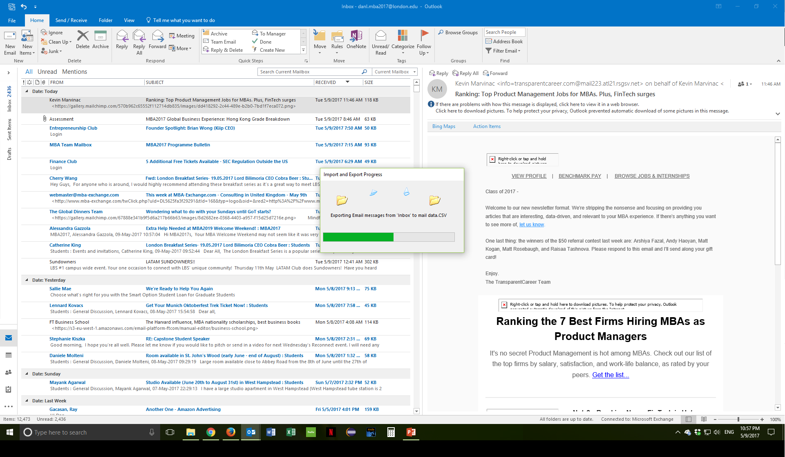
Get the Data
*Gmail
http://www.voidynullness.net/blog/2013/07/25/gmail-email-with-python-via-imap/
https://yuji.wordpress.com/2011/06/22/python-imaplib-imap-example-with-gmail/
http://stackoverflow.com/questions/14029768/python-imaplib-fetch-body-emails-gmail

Slide 4
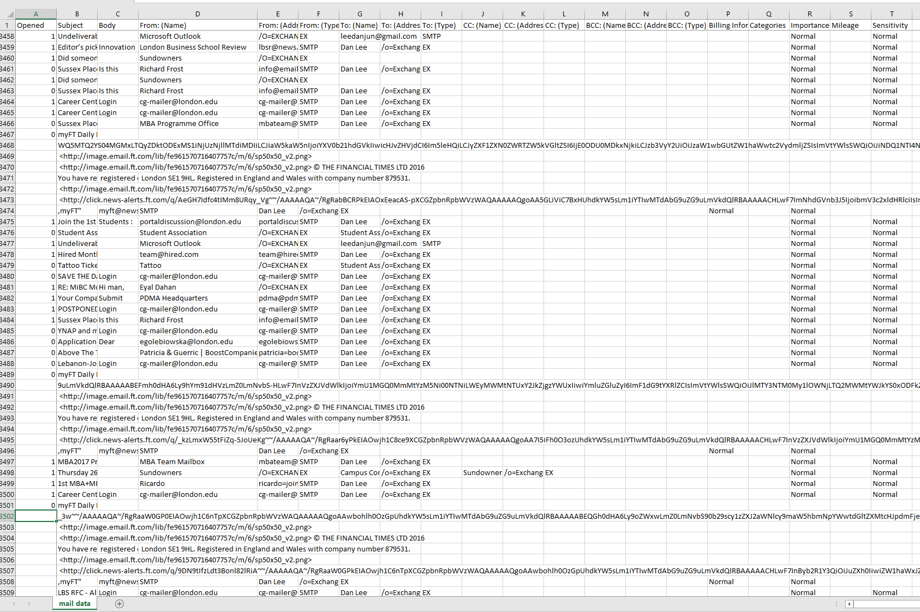
Preparing/Cleaning the Data

Slide 5
The Code

Slide 6
Future Improvements
Data
Scalable options for determining “read” or “unread”
Model
Date
Windowing
Recency Weighting
Integrate with Priority Contacts

Slide 7
Follow-on Projects
Unsubscribe Recommendations
Automatic Subfolder Creation & Filtering
Productize Model
Lambda Architecture
RESTful Web Service

